Slide 1
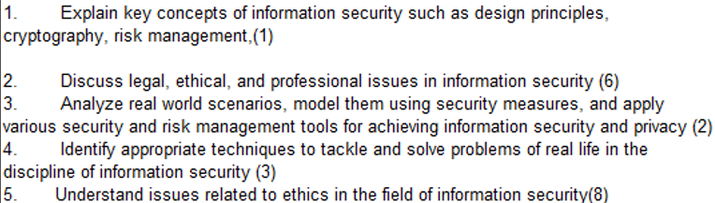
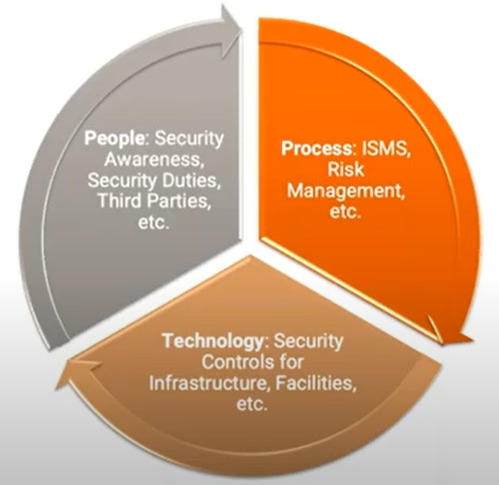
CS 3002 Information Security
Fall 2024
Week# 12 – MID-II Exam (6/11/2024) & Lecture #33
Week # 13 – Lecture# 34, 35, 36
12, 13 and 14th November 2024
Dr. Aqsa Aslam

Slide 2
Structured Query Language (SQL)
Standardized language to define schema, manipulate, and query data in a relational database
Several similar versions of ANSI/ISO standard
All follow the same basic syntax and semantics
SQL statements can be used to:
Create tables
Insert and delete data in tables
Create views
Retrieve data with query statements
Notes:
Structured Query Language (SQL) is a standardized language that can be used to
define schema, manipulate, and query data in a relational database. There are several
versions of the ANSI/ISO standard and a variety of different implementations,
but all follow the same basic syntax and semantics.
SQL statements
can be used to create tables, insert and delete data in tables, create views, and
retrieve data with query statements.

Slide 3
SQL Injection Attacks (SQLi)
One of the most prevalent and dangerous network-based security threats
Designed to exploit the nature of Web application pages
Malicious SQL commands are sent to the database server to manipulate the database.
Most common attack goal is bulk extraction of data
Depending on the environment SQL injection can also be exploited to:
Modify or delete data
Execute arbitrary operating system commands
Launch denial-of-service (DoS) attacks
Notes:
The SQL injection (SQLi) attack is one of the most prevalent and dangerous
network-based security threats. Consider the following reports:
1. The July 2013 Imperva Web Application Attack Report [IMPE13] surveyed a
cross-section of Web application servers in industry and monitored eight different
types of common attacks. The report found that SQLi attacks ranked
first or second in total number of attack incidents, the number of attack
requests per attack incident, and average number of days per month that an
application experienced at least one attack incident. Imperva observed a single
Web site that received 94,057 SQL injection attack requests in one day.
2. The Open Web Application Security Project’s 2013 report [OWAS13] on the
ten most critical Web application security risks listed injection attacks, especially
SQLi attacks, as the top risk. This ranking is unchanged from its 2010 report.
3. The Veracode 2016 State of Software Security Report [VERA16] found that
percentage of applications affected by SQLi attacks is around 35%.
4. The Trustwave 2016 Global Security Report [TRUS16] lists SQLi attacks as
one of the top two intrusion techniques. The report notes that SQLi can pose a
significant threat to sensitive data such as personally identifiable information
(PII) and credit card data, and it can be hard to prevent and relatively easy to
exploit these attacks.
In general terms, an SQLi attack is designed to exploit the nature of Web application
pages. In contrast to the static Web pages of years gone by, most current Web sites
have dynamic components and content. Many such pages ask for information, such
as location, personal identity information, and credit card information. This dynamic
content is usually transferred to and from back-end databases that contain volumes of
information—anything from cardholder data to which type of running shoes is most
purchased. An application server Web page will make SQL queries to databases to
send and receive information critical to making a positive user experience.
In such an environment, an SQLi attack is designed to send malicious SQL
commands to the database server. The most common attack goal is bulk extraction
of data. Attackers can dump database tables with hundreds of thousands of customer
records. Depending on the environment, SQL injection can also be exploited
to modify or delete data, execute arbitrary operating system commands, or launch
denial-of-service (DoS) attacks.

Slide 4
Important SQL Syntax
COMMENTS: --
In SQL, the -- symbol starts a comment. Everything after -- is ignored by the SQL engine.
Attackers often use it to ignore the rest of the query.
Example: SELECT * FROM `table` --selects everything
This allows an attacker to add malicious parts to a query and comment out the original conditions.
LOGIC: ‘a’=‘a’
Attackers can use tautologies, such as 'a'='a', to make conditions always true.
Example: SELECT * FROM `table` WHERE ‘a’=‘a’
This bypasses restrictions and retrieves all data from the table, as the condition always evaluates as true.
MULTI STATEMENTS: S1; S2
Some SQL engines allow multiple statements to be executed in one go, separated by a semicolon (;).
Example: SELECT * FROM table; DROP TABLE table;
The query retrieves all data from the table and then immediately deletes it.

Slide 5
SQLi Attack Avenues
User input
Attackers inject SQL commands by providing suitable crafted user input
Server variables
Attackers can forge the values that are placed in HTTP and network headers and exploit this vulnerability by placing data directly into the headers
Second-order injection
A malicious user could rely on data already present in the system or database to trigger an SQL injection attack, so when the attack occurs, the input that modifies the query to cause an attack does not come from the user, but from within the system itself
Cookies
An attacker could alter cookies such that when the application server builds an SQL query based on the cookie’s content, the structure and function of the query is modified
Physical user input
Applying user input that constructs an attack outside the realm of web requests
Notes:
We can characterize SQLi attacks in terms of the avenue of attack and the type of
attack [CHAN11, HALF06]. The main avenues of attack are as follows:
• User input: In this case, attackers inject SQL commands by providing suitably
crafted user input. A Web application can read user input in several
ways based on the environment in which the application is deployed. In most
SQLi attacks that target Web applications, user input typically comes from
form submissions that are sent to the Web application via HTTP GET or
POST requests. Web applications are generally able to access the user input
contained in these requests as they would access any other variable in the
environment.
• Server variables: Server variables are a collection of variables that contain
HTTP headers, network protocol headers, and environmental variables. Web
applications use these server variables in a variety of ways, such as logging
usage statistics and identifying browsing trends. If these variables are logged
to a database without sanitization, this could create an SQL injection vulnerability.
Because attackers can forge the values that are placed in HTTP and
network headers, they can exploit this vulnerability by placing data directly
into the headers. When the query to log the server variable is issued to the
database, the attack in the forged header is then triggered.
• Second-order injection: Second-order injection occurs when incomplete
prevention mechanisms against SQL injection attacks are in place. In second-order
injection, a malicious user could rely on data already present in the
system or database to trigger an SQL injection attack, so when the attack
occurs, the input that modifies the query to cause an attack does not come
from the user, but from within the system itself.
• Cookies: When a client returns to a Web application, cookies can be used
to restore the client’s state information. Because the client has control over
cookies, an attacker could alter cookies such that when the application server
builds an SQL query based on the cookie’s content, the structure and function
of the query is modified.
• Physical user input: SQL injection is possible by supplying user input that
constructs an attack outside the realm of web requests. This user-input could
take the form of conventional barcodes, RFID tags, or even paper forms which
are scanned using optical character recognition and passed to a database management
system.

Slide 6
SQLi Attack Avenues
User input
Example: Consider a login form where a user enters their username and password. If the SQL query to authenticate a user is constructed as:
SELECT * FROM users WHERE username = '" + username + "' AND password = '" + password + "';"
An attacker could enter " OR "1"="1 as both username and password.
This would result in the following query:
SELECT * FROM users WHERE username = "" OR "1"="1" AND password = "" OR "1"="1";
The condition 1=1 is always true, which bypasses the login check, allowing the attacker to gain unauthorized access.

Slide 7
User input explanation
Imagine you have a login system that checks if the username and password are correct by running an SQL query like this:
SELECT * FROM users WHERE username = 'entered_username' AND password = 'entered_password’;
Let’s go through it with an example.
Step 1: Normal Login
For a normal user, if they enter:
Username: john
Password: mypassword
The query would look like this:
SELECT * FROM users WHERE username = 'john' AND password = 'mypassword';
This query will only return a result if there’s a user with username = 'john' and password = 'mypassword' in the database.
Step 2: SQL Injection Attempt
Now, let’s say an attacker tries to trick the system by entering:
Username: " OR "1"="1
Password: " OR "1"="1
When these inputs are added to the query, it becomes:
SELECT * FROM users WHERE username = '" OR "1"="1' AND password = '" OR "1"="1';

Slide 8
Step 3: How the Injection Works
Let’s break down this injected query:
username = '" OR "1"="1': Here, the part OR "1"="1 is always true.
password = '" OR "1"="1': Similarly, this part OR "1"="1 is also always true.
So the query effectively becomes:
SELECT * FROM users WHERE (username = '' OR "1"="1") AND (password = '' OR "1"="1");
The conditions OR "1"="1 are always true, meaning the query will return results even without a matching username or password

Slide 9
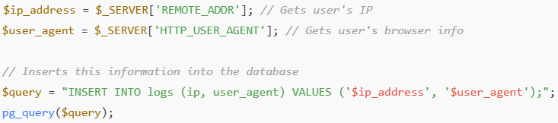
SQLi Attack Avenues
Server variables
The application logs HTTP headers, including User-Agent, to a database.
An attacker manipulates this header:
User-Agent: '); DROP TABLE logs; --
The database query logs the User-Agent, which now includes malicious code that drops the logs table.
Second order injection
An attacker registers with a username like john'; DROP TABLE orders; --. This username is stored in the database. Later, when an admin views user profiles, this stored SQL executes, dropping the orders table.

Slide 10
SQLi Attack Avenues
Cookies
The application uses a UserID cookie to retrieve user data:
SELECT * FROM users WHERE id = '" + $_COOKIE["UserID"] + “’;”
The attacker modifies their cookie to 1'; DROP TABLE users; --.
When the query executes, it deletes the users table.
Physical user input
An attacker encodes a barcode with:
'; DROP TABLE inventory; --
When the barcode is scanned, the SQL command executes, dropping the inventory table.

Slide 11
SQL Injection
login.php:
$result = pg_query("SELECT * from users WHERE
uid = '".$_GET['user']."' AND
pwd = '".$_GET['pwd']."';");
if (pg_query_num($result) > 0) {
echo "Success";
user_control_panel_redirect();
}
Q: Which one of the following queries will log you in as admin? Hints: The SQL language supports comments via '--' characters.
a.
b.
c.
http://www.example.net/login.php?user=admin&pwd='
http://www.example.net/login.php?user=admin--&pwd=foo http://www.example.net/login.php?user=admin'--&pwd=f
Notes:
Presenter
2012-11-07 20:33:38
--------------------------------------------
Hint: Look at what is the actual query that will be executed

Slide 12
SQL Injection -- Explanation
Q: Which one of the following queries will log you in as admin? Hints: The SQL language supports comments via '--' characters.
a.
b.
c.
http://www.example.net/login.php?user=admin&pwd='
Here, pwd is set to an empty string (''). If there's a password check, this will likely fail unless the password is actually an empty string. It doesn't use the -- comment trick, so it won’t bypass any authentication checks that require a password.
SELECT * FROM users WHERE uid = 'admin' AND pwd = '';
http://www.example.net/login.php?user=admin--&pwd=foo
Here, admin-- is treated as a username (it includes -- as part of the username). Since the -- is not isolated as a comment, it doesn’t make the rest of the query into a comment. This query would fail because the username is admin--, not admin.
SELECT * FROM users WHERE uid = 'admin--' AND pwd = 'foo’;
http://www.example.net/login.php?user=admin'--&pwd=f
SELECT * FROM users WHERE uid = 'admin'--' AND pwd = 'f’;
The -- here turns the rest of the line into a comment, effectively bypassing the password check
SELECT * FROM users WHERE uid = 'admin';

Slide 13
SQL Injection
login.php:
$result = pg_query("SELECT * from users WHERE
uid = '".$_GET['user']."' AND
pwd = '".$_GET['pwd']."';");
if (pg_query_num($result) > 0) {
echo "Success";
user_control_panel_redirect();
URI: http://www.example.net/login.php?user=admin'--&pwd=f
pg_query("SELECT * from users WHERE
uid = 'admin'--' AND
pwd = 'f';");
pg_query("SELECT * from users WHERE
uid = 'admin';");
Notes:
Presenter
2012-11-07 20:33:38
--------------------------------------------
With the URI we thus make the password check a comment in SQL and therefore the resulting SQL only SELECTS the row using uid as admin.

Slide 14
SQL Injection
Q: Under the same premise as before, which URI can delete the users table in the database?
www.example.net/login.php?user=;DROP TABLE users;--
www.example.net/login.php?user=admin%27%3B%20DROP%20TABLE%20users--%3B&pwd=f
www.example.net/login.php?user=admin;%20DROP%20TABLE%20users;%20--&pwd=f
It is not possible. (None of the above)

Slide 15
SQL Injection
Q: Under the same premise as before, which URI can delete the users table in the database?
a.
b.
c.
d.
www.example.net/login.php?user=;DROP TABLE users;--
This URL might not work because it doesn’t specify a username before the ; , which can cause a syntax error in SQL.
Many SQL systems require a value before commands, so this one is less likely to execute properly.
www.example.net/login.php?user=admin%27%3B%20DROP%20TABLE%20users--%3B&pwd=f
admin%27 (%27 is ') closes the username value.
%3B represents ;, which allows starting a new command.
DROP TABLE users attempts to delete the table.
-- comments out the rest of the SQL query so no password check is applied.
SELECT * FROM users WHERE uid = 'admin'; DROP TABLE users; --' AND pwd = 'f';
This query could run successfully and delete the users table.
www.example.net/login.php?user=admin;%20DROP%20TABLE%20users;%20--&pwd=f
This might not work because admin; and DROP TABLE users; are not enclosed in quotes, which could cause SQL syntax errors in most systems.
It is not possible. (None of the above)

Slide 16
SQL Injection
Q: Under the same premise as before, which URI can delete the users table in the database?
www.example.net/login.php?user=;DROP TABLE users;--
www.example.net/login.php?user=admin’; DROP TABLE users;--&pwd=f
www.example.net/login.php?user=admin; DROP TABLE users; --&pwd=f
It is not possible. (None of the above)
(Decoded)
pg_query("SELECT * from users WHERE
uid = 'admin'; DROP TABLE users;--' AND pwd = 'f';");
pg_query("SELECT * from users WHERE uid = 'admin'; DROP TABLE users;");
Notes:
Presenter
2012-11-07 20:33:38
--------------------------------------------
Notice how there are now two queries?

Slide 17
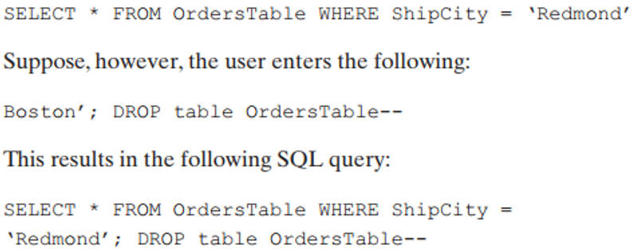
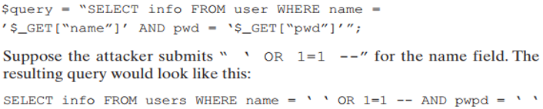
SQL Injection – Summary

Slide 18
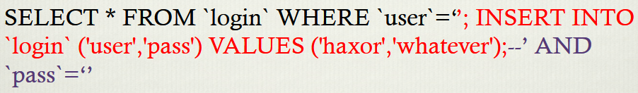
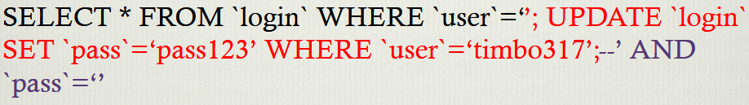
SQL Injection – Summary

Slide 19
Injection Defenses
Defenses:
Input validation
Whitelists untrusted inputs to a safe list.
Input escaping
Escape untrusted input so it will not be treated as a command.
Use less powerful API
Use an API that only does what you want
Prefer this over all other options.
Notes:
Presenter
2012-11-07 20:33:38
--------------------------------------------
Only use the first two solutions if this is infeasible.

Slide 20
Input Validation for SQL
login.php:
 | <?
 | if(!preg_match("/^[a-z0-9A-Z.]*$/", $_GET[‘user'])) {
 | echo "Username should be alphanumeric.";
 | return;
 | }
 | // Continue to do login query
 | ?>
GET INPUT |  |  |  |  |  | PASSES?
Pikachu |  |  |  |  |  | Yes
Pikachu’; DROP TABLE users-- |  |  |  |  |  | No
O’Donnel |  |  |  |  |  | No
Notes:
Presenter
2012-11-07 20:33:38
--------------------------------------------
The regular expression ensures the username is in a strict whitelist.
Note that, this is often not practical. Names such as O’Donnel or T’Pau.

Slide 21
Input Escaping
$_GET['user'] = pg_escape_string($_GET['user']);
$_GET['pwd'] = pg_escape_string($_GET['pwd']);
pg_escape_string() escapes a string for querying the PostgreSQL database. It returns an escaped literal in the
PostgreSQL format. GET INPUT
 | Escaped Output
Bob | Bob
Bob'; DROP TABLE users; -- | Bob''; DROP TABLE users; --
Bob' OR '1'='1 | Bob'' OR ''1''=''1
Notes:
Presenter
2012-11-07 20:33:39
--------------------------------------------
Escaping is easy to get wrong. Other functions, e.g., addslashes are very similar, but not sufficient. Similarly, in case of mysql DB APIs, the mysql_escape_string function was initially recommended, but was found to have bugs. So currently, mysql_real_escape_string function is recommended. As we discuss next, this is an unnecessary race. Always prefer to use parameterized queries which give you much stronger guarantees.

Slide 22
Use less powerful API : Prepared Statements
Create a template for SQL Query, in which data values are substituted.
The database ensures untrusted value isn’t interpreted as command.
Always prefer over all other techniques.
Less powerful:
– Only allows queries set in templates.

Slide 23
Use less powerful API : Prepared Statements
<?
# The $1 and $2 are a ‘hole’ or place holder for what will be filled by the data
$result = pg_query_params('SELECT * FROM users WHERE
uid = $1 AND
pwd = $2', array($_GET['user'], $_GET[‘pwd']) );
# Compare to
$result = pg_query("SELECT * FROM users WHERE
uid ='".$_GET['user']."' AND
pwd ='".$_GET[‘pwd']."‘;");
?>
Notes:
Presenter
2012-11-07 20:33:39
--------------------------------------------
Regular database query using pg_query is not guaranteed to be one single query and may actually end up being multiple queries.
Input in prepared statement is always interpreted as a data value. The database will NOT make any deviations from the prepared query such as evaluate other queries, conditionals, or expressions.

Slide 24
Recap
SQL Injection: a case of injection, in database queries.
Extremely common, and pervasively exploited.
Use prepared statements to prevent SQL injection
– DO NOT use escaping, despite what xkcd says.
Next, injection in the browser.

